Slide 1

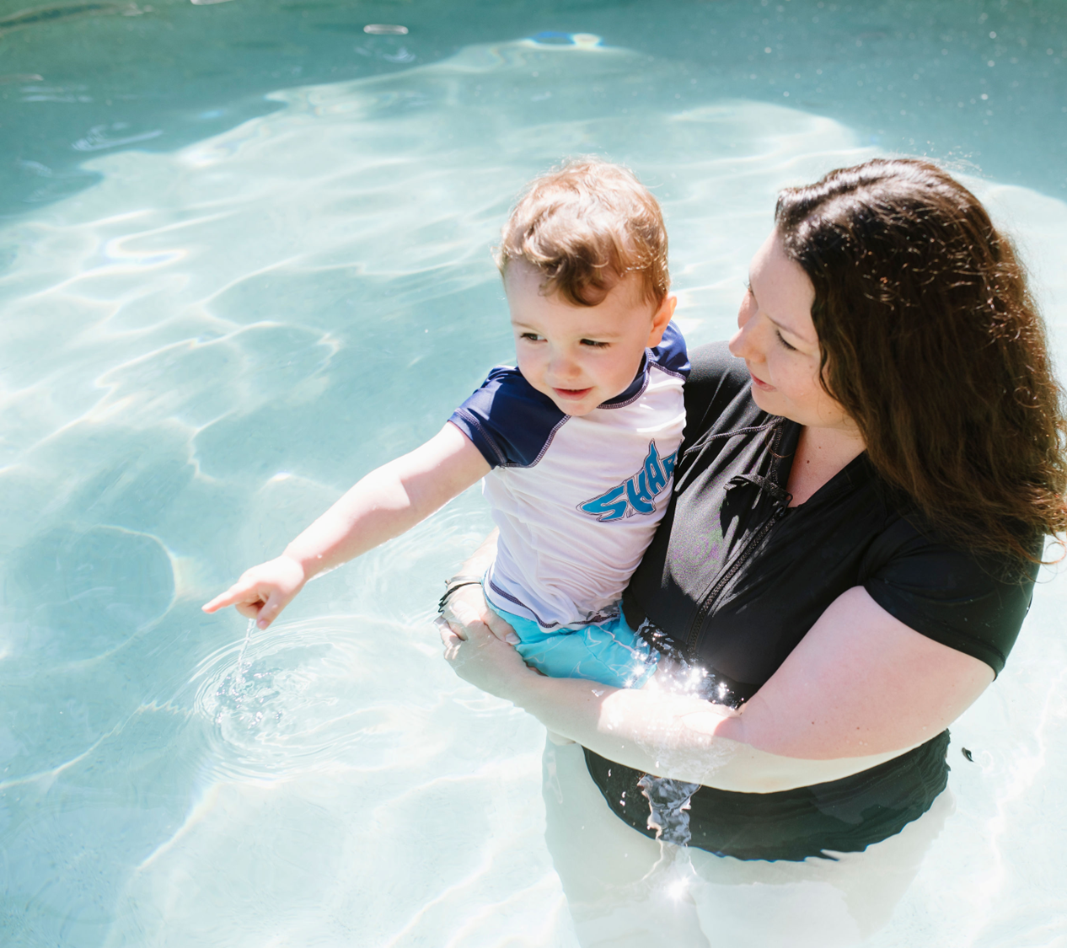

STAFF TRAINING – PROGRAM IMPLEMENTATION

Slide 2

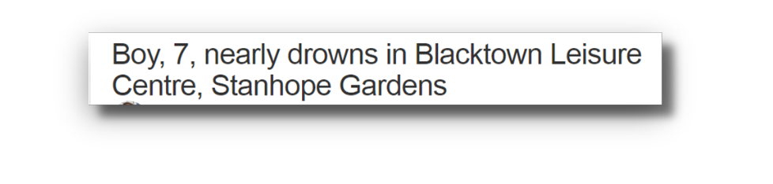

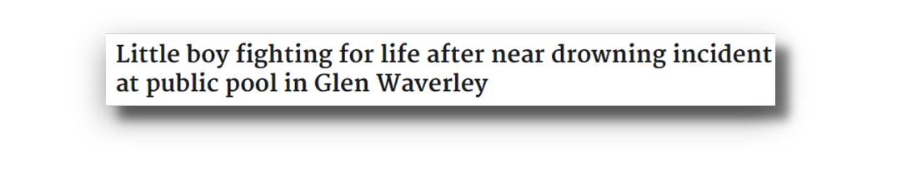
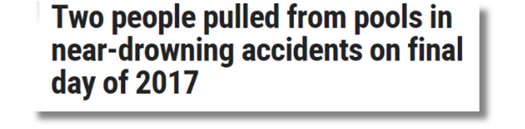

Drowning at public pools

Slide 3

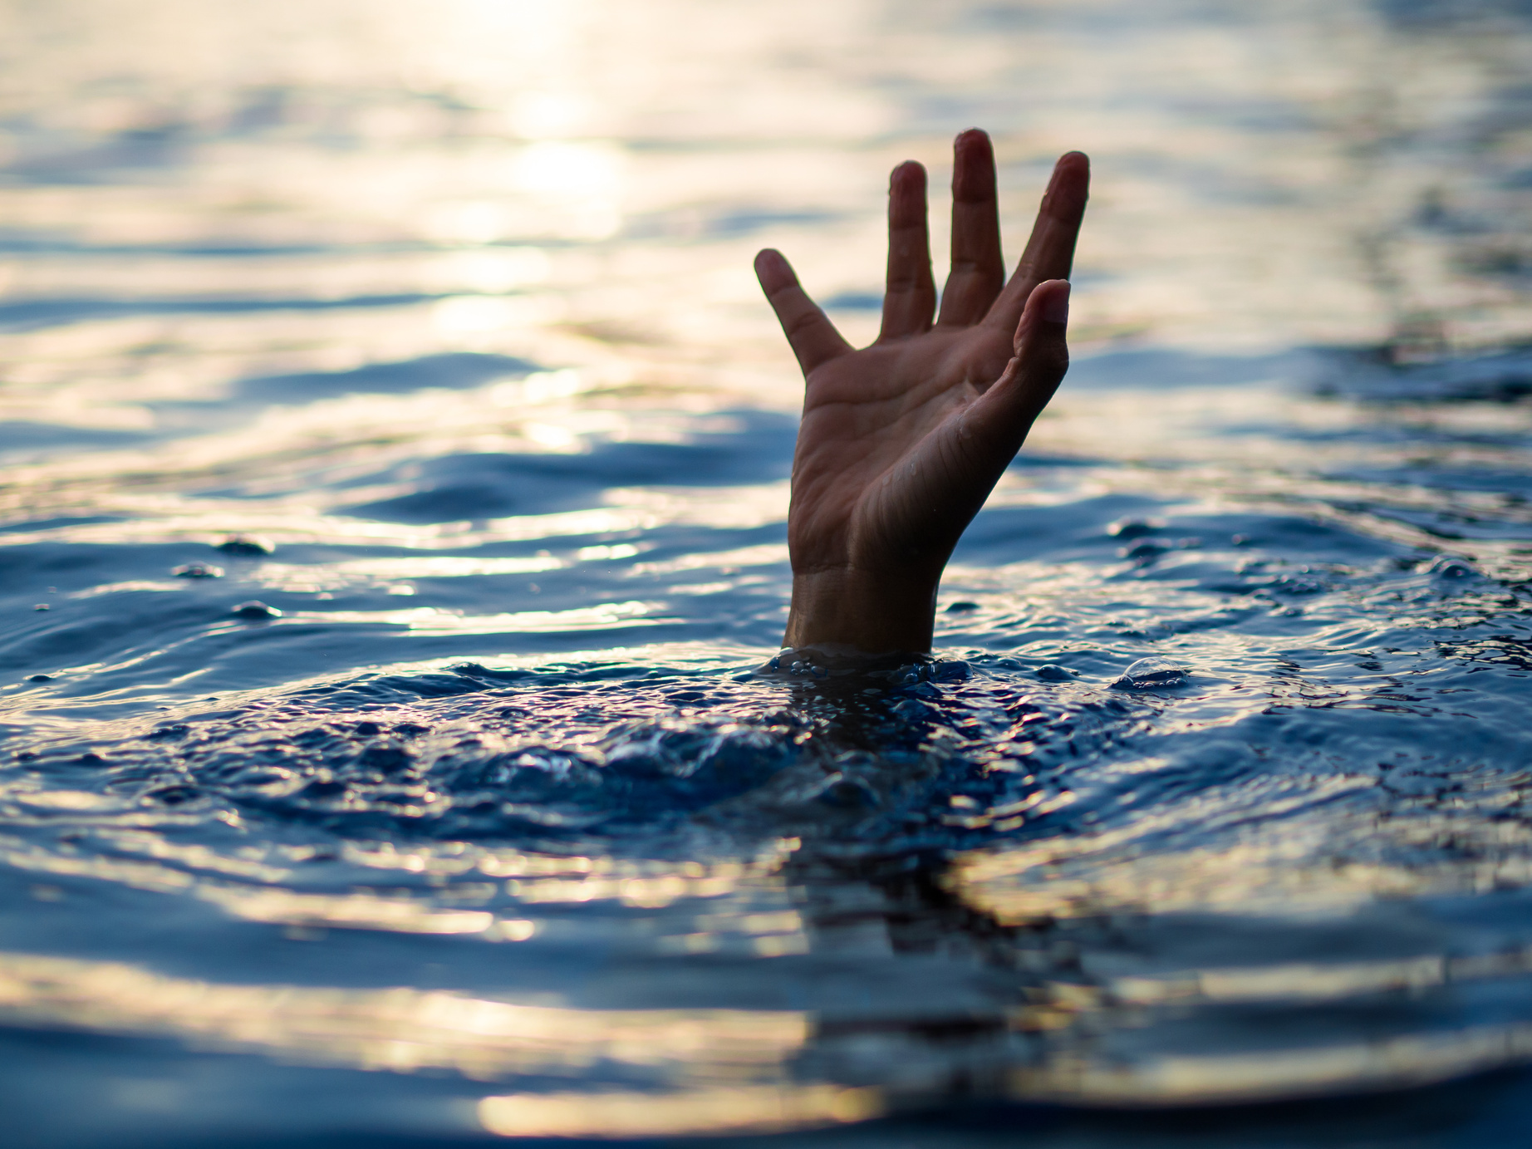
Drowning in Australia
357
people drowned in Australian Waterways
between 1 July 2024 - 30 June 2025

Slide 4

Drowning in Australia
81%
24%
were males
drowned whilst swimming and recreating
32%
were people born overseas

Slide 5
Child drowning
15
53% were unintentional falls into water
children 0-4 years drowned in 2024/25
53% occurred in swimming pools
13% occurred whilst swimming and recreating

Slide 6

Drowning in Australia
Children aged 1, accounted for 40% of 0-4 drowning deaths
Drowning risk triples following a child’s first birthday.

Slide 7
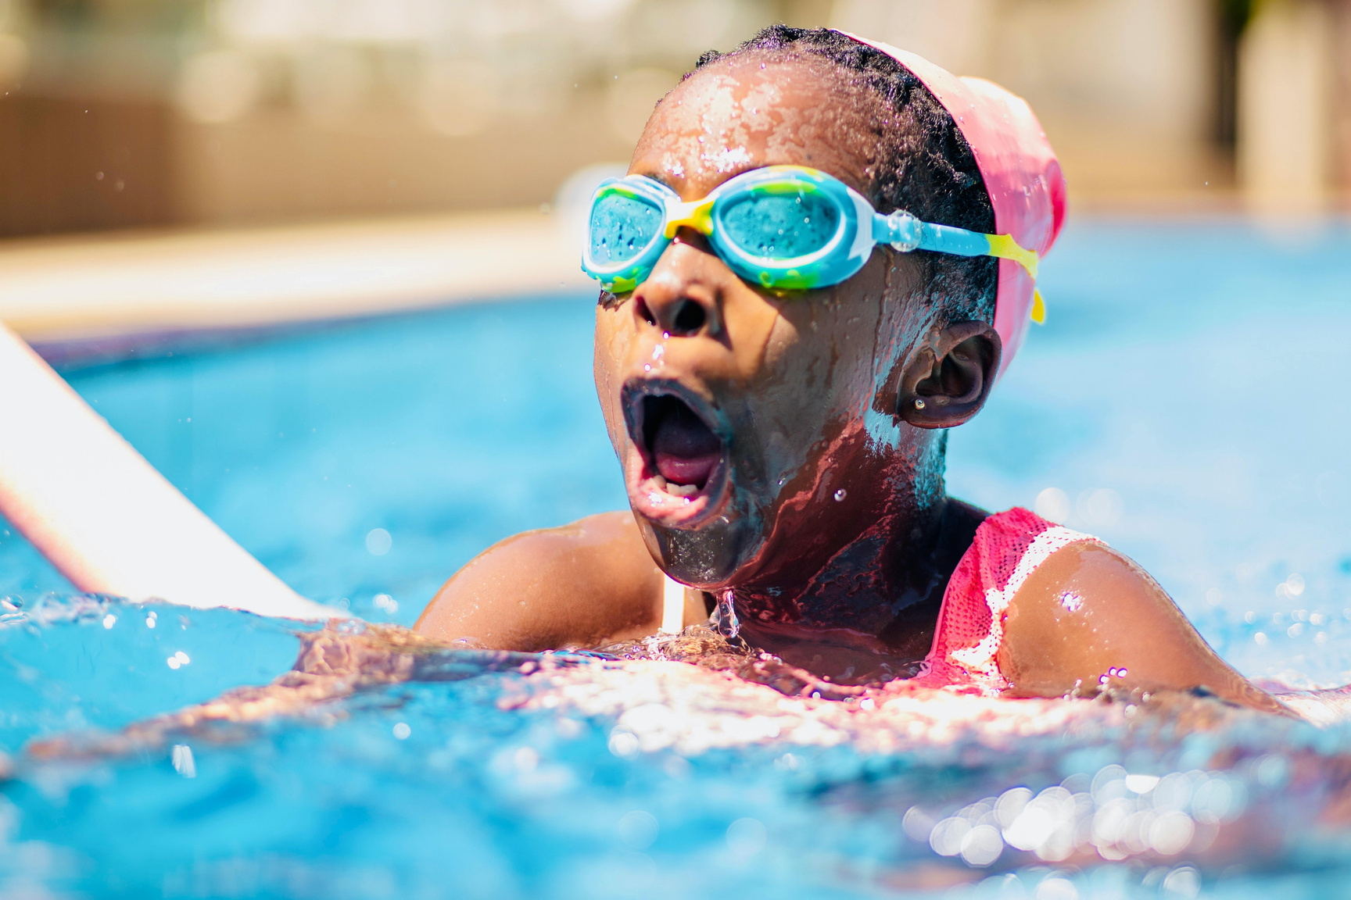

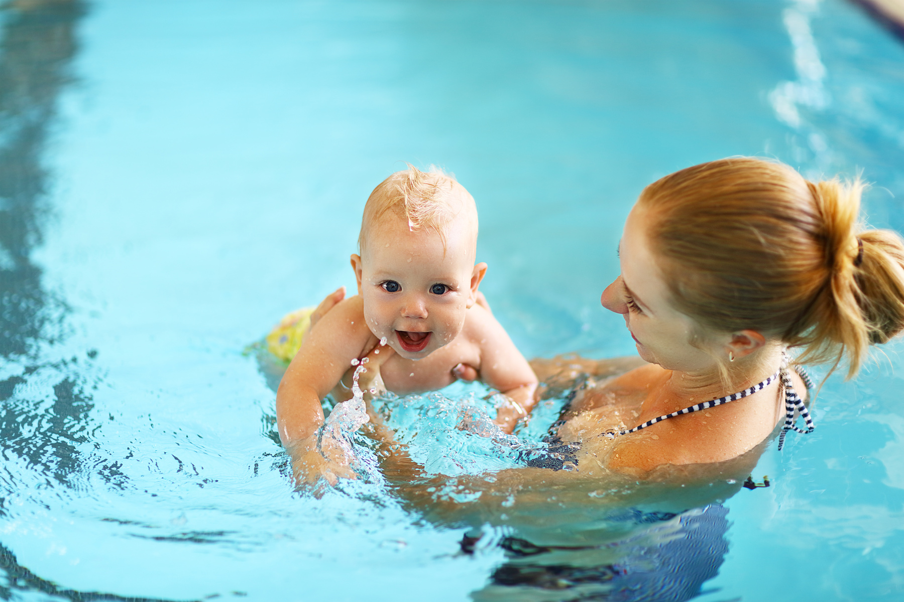

Drowning in Australia
For every child drowning fatalities there are an estimated 7 non-fatal drowning incidents that require hospitalisation.

Slide 8
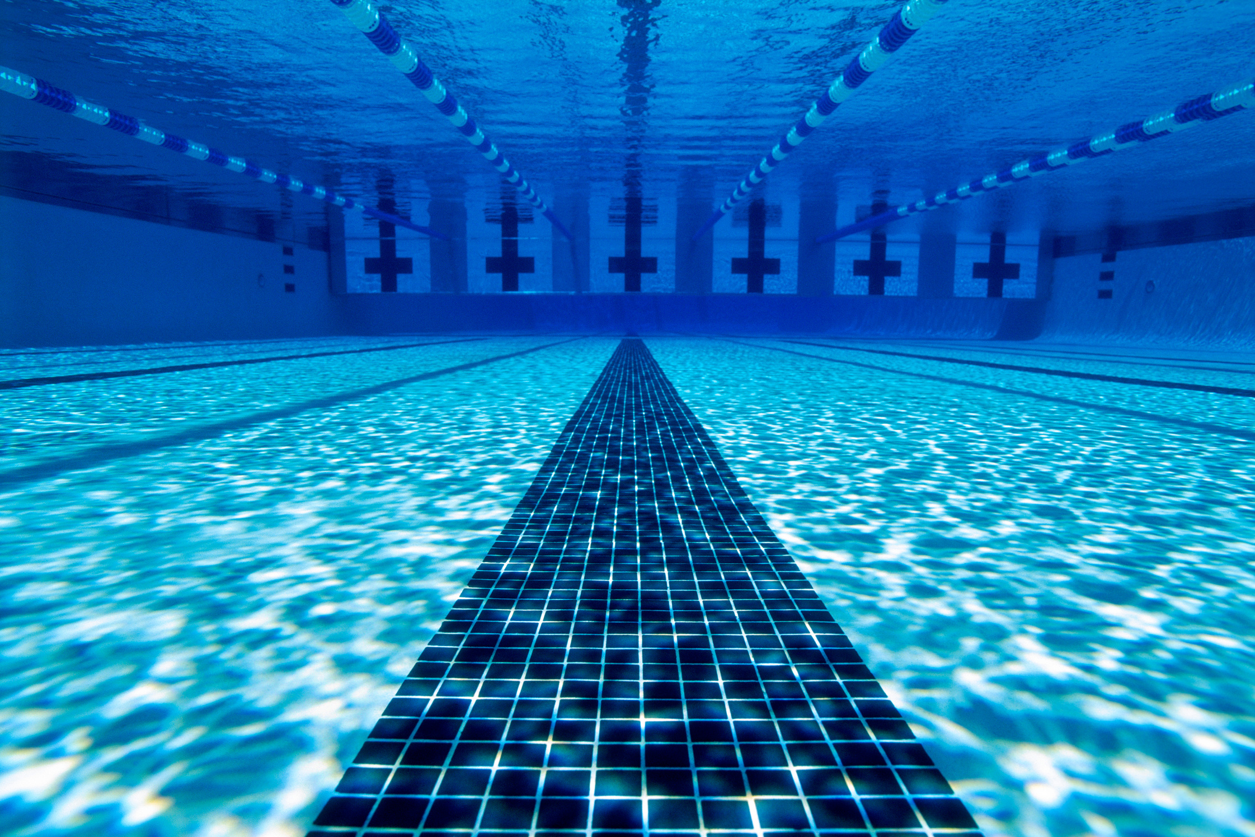
Rescues at public pools
In Australian aquatic centres throughout 2024-25
~8000
1
Rescues were performed
~21
rescue every 45minutes
rescues every
day

Slide 9
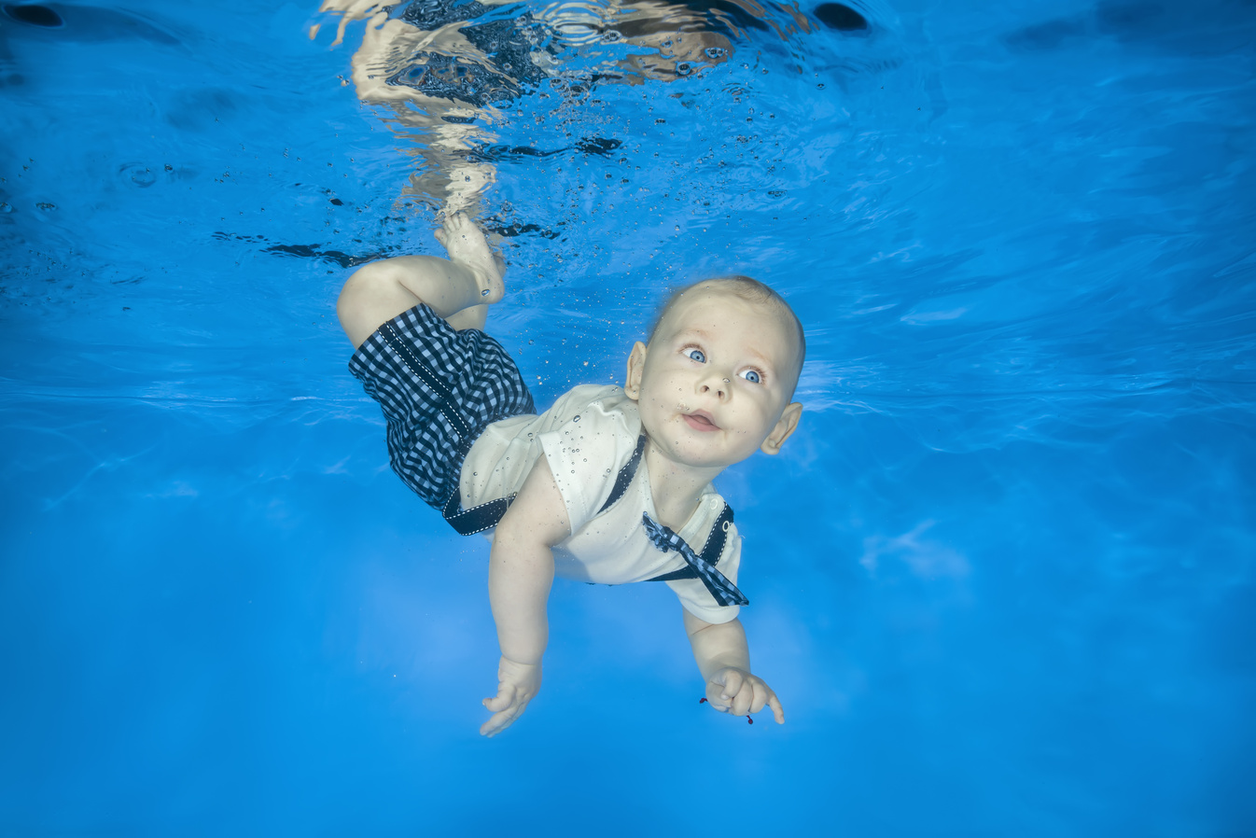
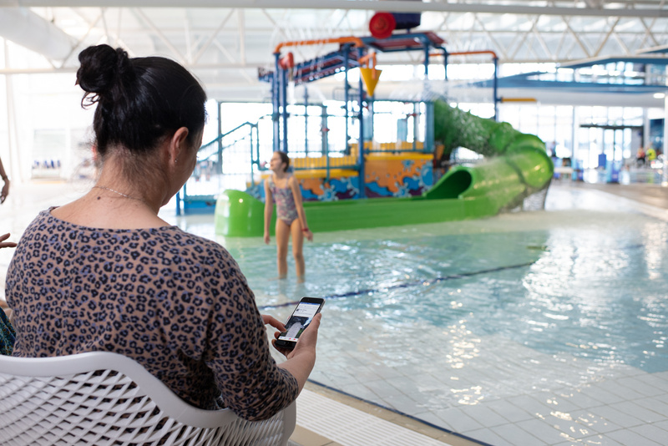
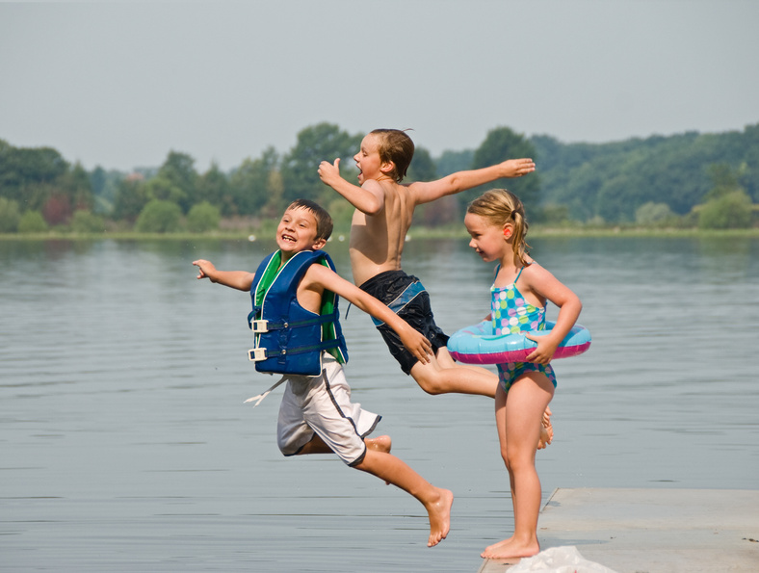
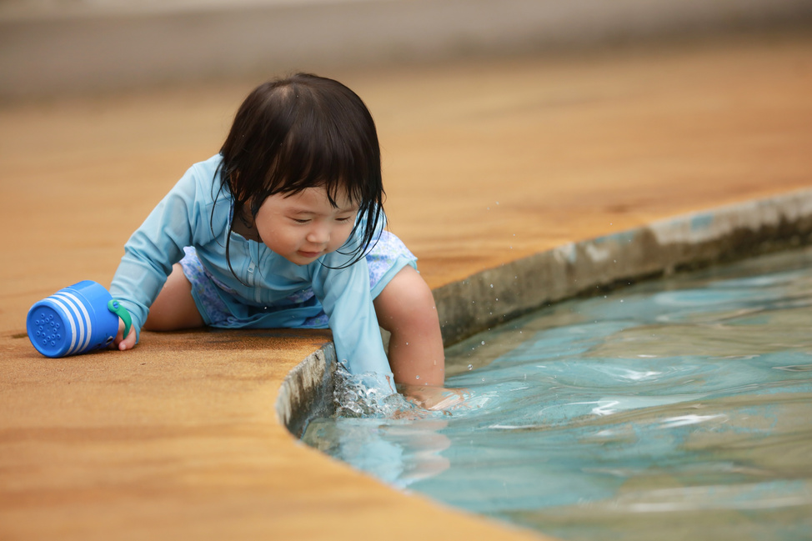
Why children are at risk
  Children are attracted to water
  Do not understand DANGER
  Absence or lack of adult supervision
  False sense of security
  Silent event

Slide 10
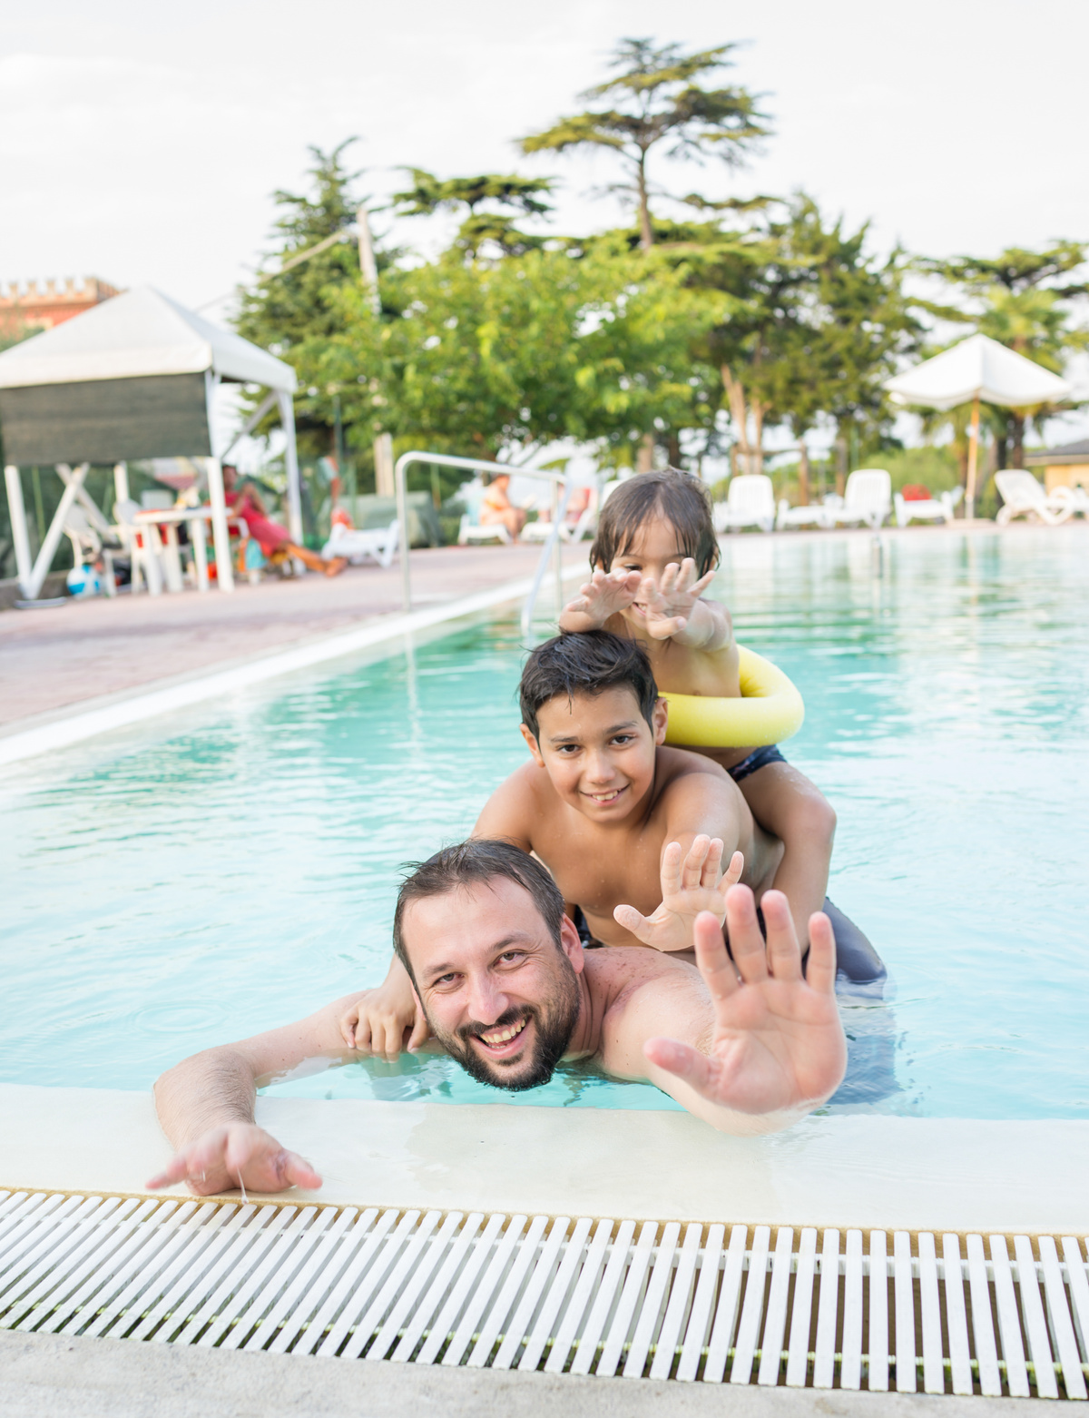

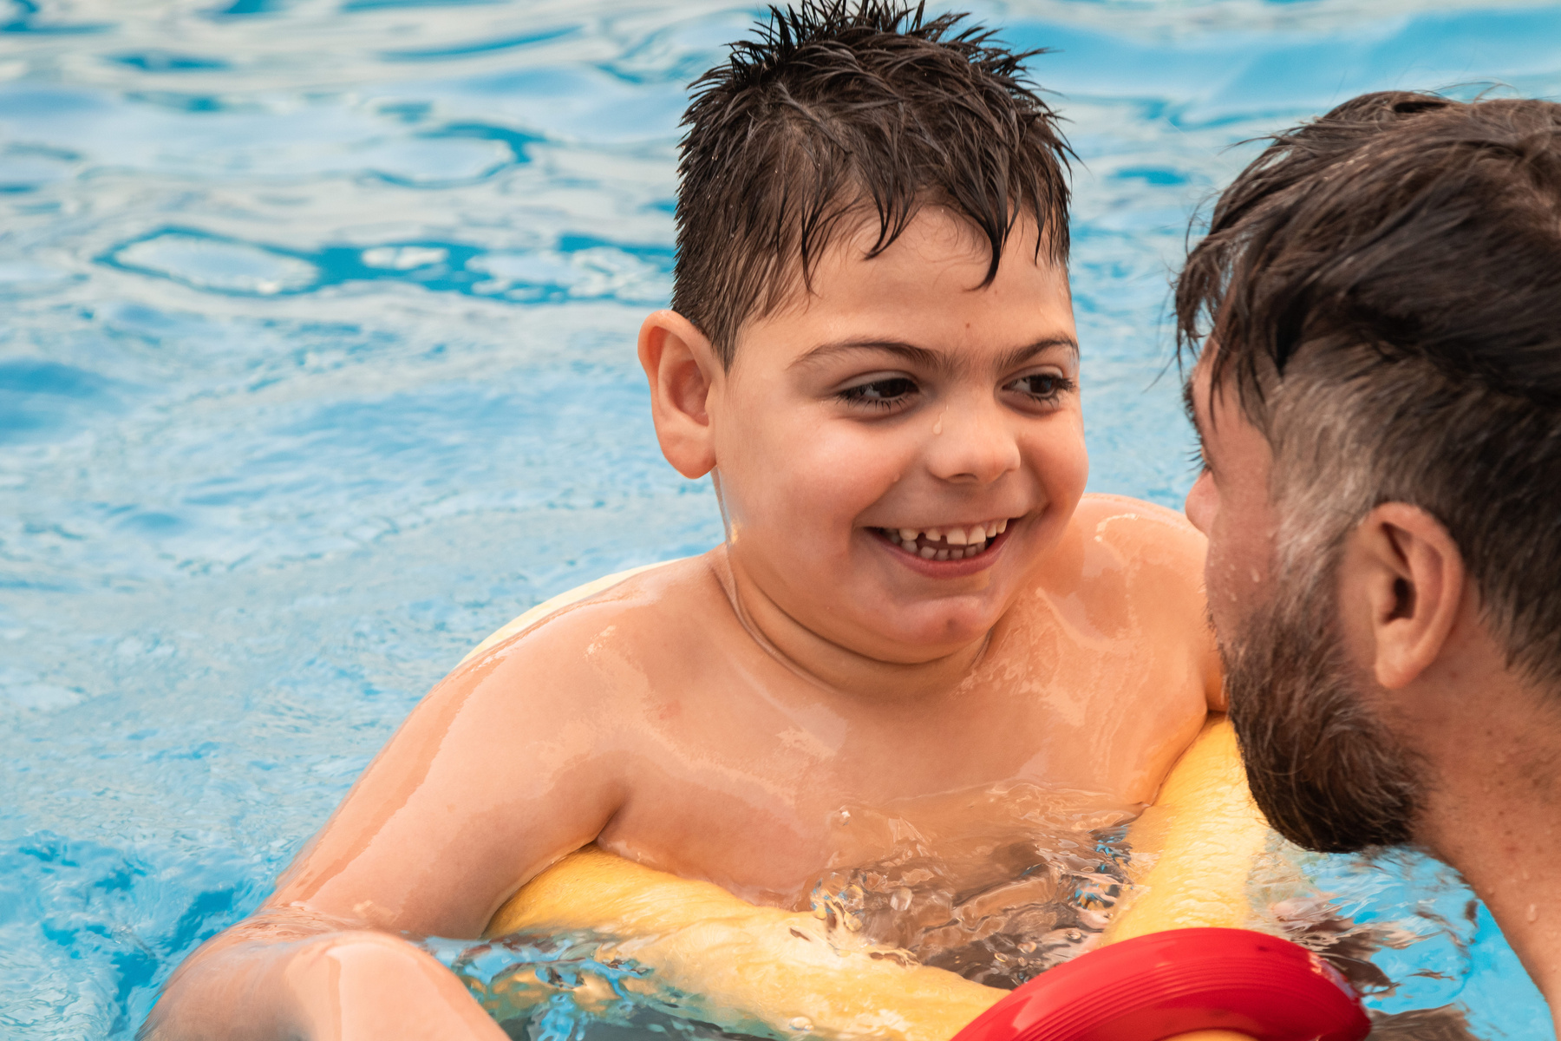
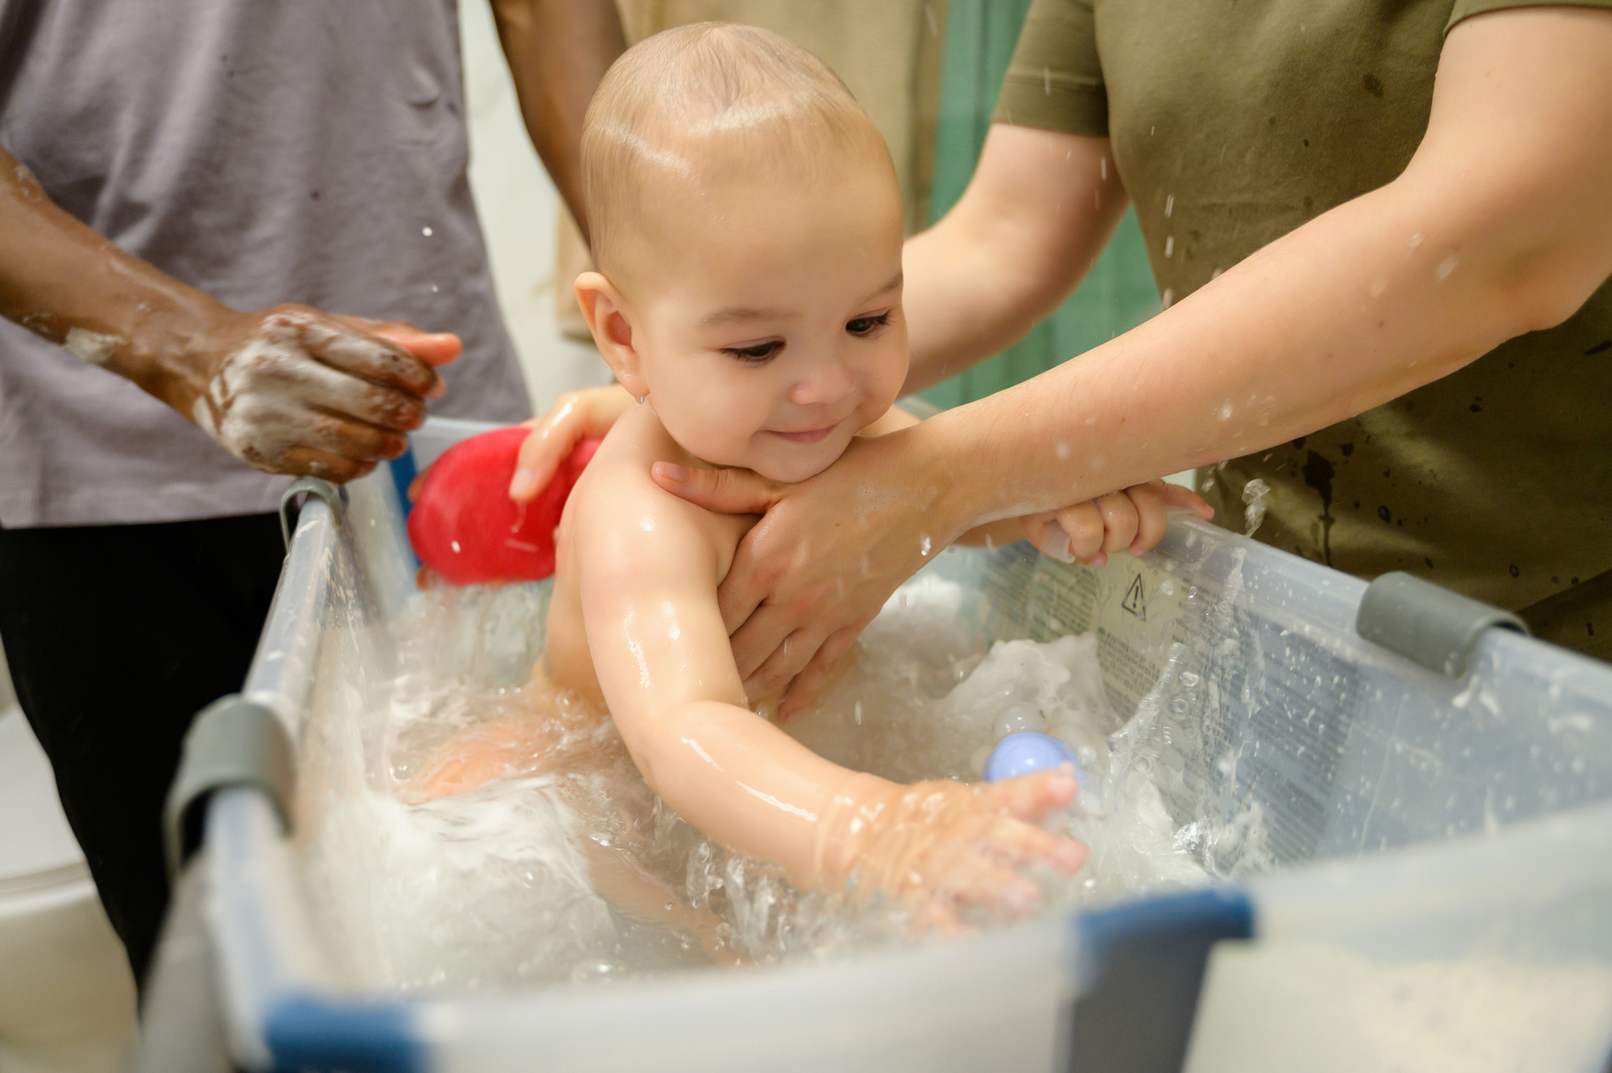
Keep Watch Program Purpose
To prevent drowning in children through supervision, safe environments, early learning, and emergency response
Notes:
It is targeted at parents and carers of children.
Help them understand the dangers of leaving children unattended in or around water.

Slide 11
Keep Watch Program History
1993 - Royal Life Launches Keep Watch in response to high toddler drowning rates
2000's - Expansion of Keep Watch beyond pools to include bathtubs, dams, beaches and other hazards
2020's - National Program promoting 4 key actions, saving lives through education, advocacy and layered protection strategies
1993-1999 - Advocacy drives stronger pool fencing legislation across Australia
2010's - Development of multimedia campaigns, partnerships with childcare, health, and community organisations

Slide 12
Keep Watch - what’s involved
Being a Keep Watch Partner venue involves not only having the signage in place, but also educating parents and carers of the dangers and need of supervising their children.
It involves ensuring staff are properly trained and prepared to provide the appropriate education to all relevant persons and enforcing the program at all times.

Slide 13
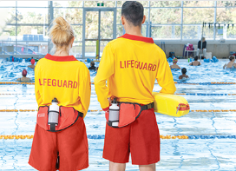
Responsibilities
Parents/carers are responsible for the supervision and care of all children within their care.
Lifeguards and other aquatic staff assist in ensuring the venue is a safe place for all persons

Slide 14
Parental Supervision
The Keep Watch Program identifies 4 key elements of parental Supervision
Be Prepared
Be Close
All your Attention
All of the Time
Parents/carers should ensure they are fully prepared to enter the water and have all items they need at hand.
Always stay within arms reach of your child
Focus all of your attention on your child - no distractions
Never leave children alone in the water if U/5years
Do not leave them in the care of an older child or lifeguard whilst at the pool
Notes:
Proximity:
Touching and within reach
Attention: Engagement/interaction with child, visual and auditory connection
Continuity:
Continuous or intermittent

Slide 15


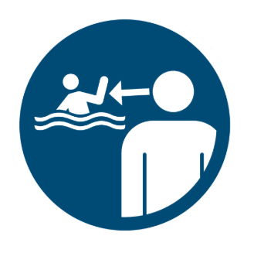
Keep Watch Policy
0-5 year olds and Non-Swimmers
6-10 year olds and Weak Swimmers
11-14 year olds
Parents / carers must stay within arms reach
Parents / carers must be close close, be prepared and maintain constant visual contact
Parents / carers must maintain visual contact

Slide 16

Implementation
Venues can easily implement the Keep Watch Program through the following steps:
1) Become a Program Partner
2) Include program principles in induction and in-service training
3) Display signage materials in key locations
4) Utilise additional resources to provide ongoing community education

Slide 17

Implementation
Key signage placements:
  Entry to venue (Entry sign)
  Bathroom doors or entry (A4 posters or wall sign)
  Pathways/ concourses near key pool locations i.e., toddler pools, splash pads, shallow end, program pools etc. (concourse signs, banners or bollards)
  Cafe areas, playgrounds, seating areas (bollards, concourse signs, wall signs, banners)

Slide 18
Implementation
Key Resources:
  Wristbands - handed out to all children U/5years
  Flyers - Handed out upon entry or when providing community education
  Digital media - social media posts, campaigns, regular awareness

Slide 19
Implementation by Staff
Front of House
Swim Instructors
Lifeguards
  First point of contact - mention the keep watch program and provide reminders of supervision
  Hand out wristbands to children under 5 years
  Ensure the display of Keep watch resources and materials
  If people comment that they have not heard of the program, provide them with a flyer
  Parent briefings - remind parents at the start of the term of their supervision responsibilities
  Use lessons to educate the students a bout safe behaviour around water and the need for parental supervision
  Encourage parents to collect children from the water after the lesson and not run off
  Actively observe and identify unsupervised children or distracted parents
  Encourage (respectfully) proper child supervision and provide education
  Engage with patrons to consistently enforce supervision
  Make public reminders over the PA during peak times

Slide 20
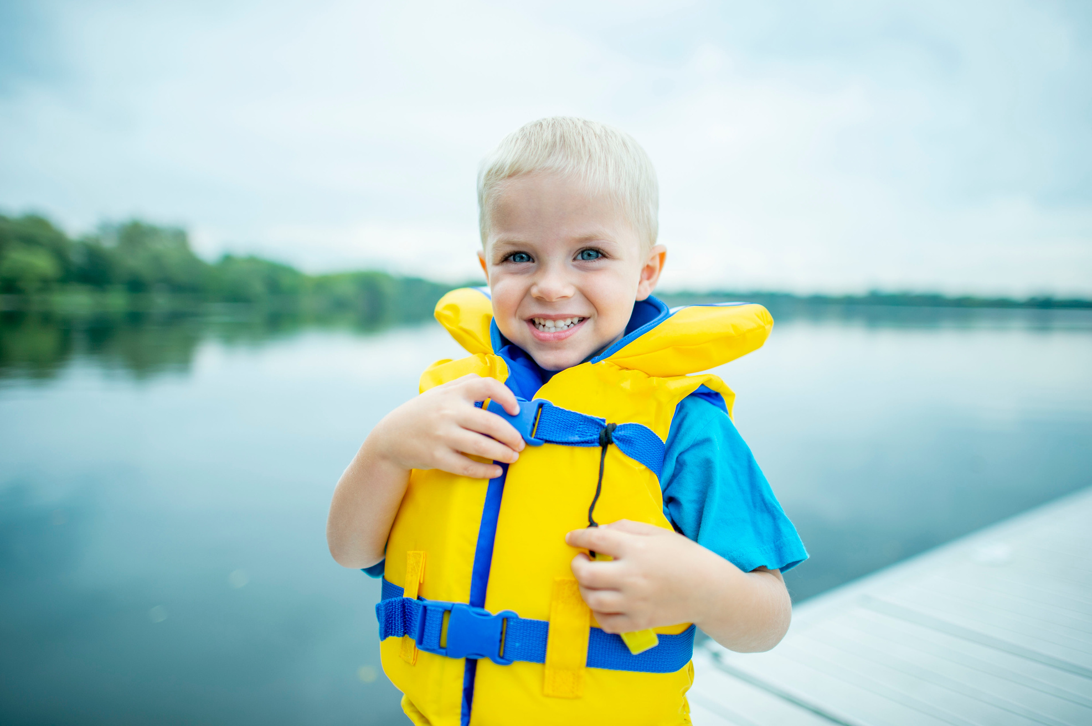
Implementation
Community Education opportunities:
  Host a water safety workshop
  LTS water safety week - child supervision session
  Have a chat with every parent / carer
  Regular PA announcements throughout the day
  Share campaigns on venue social platforms
  Visit schools / child care centres to deliver water safety sessions

Slide 21
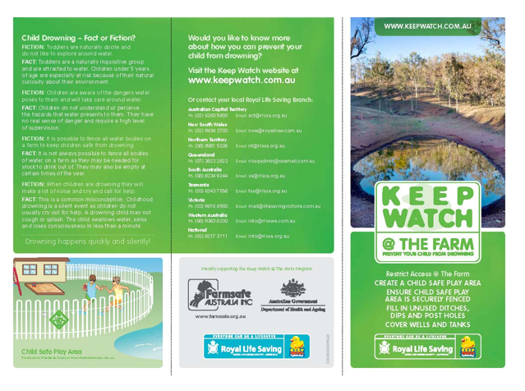

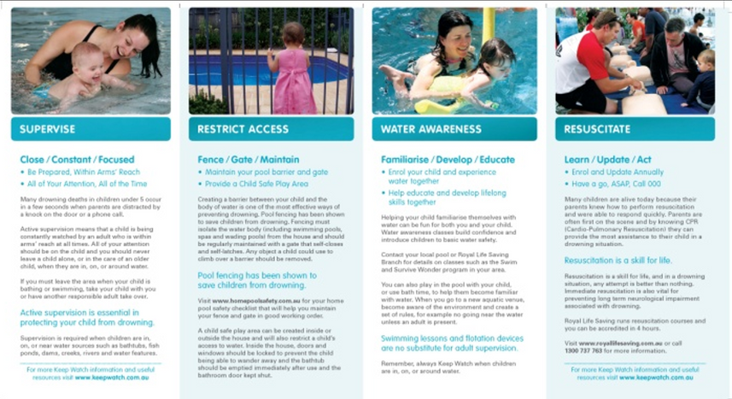
Additional Resources
Additional Resources are available for venues to include in information packs, water safety talks, etc. Please contact your state office for more information.
Keep Watch
@ the Farm
Keep Watch
@ Bath Time
Keep Watch
Brochure

Slide 22
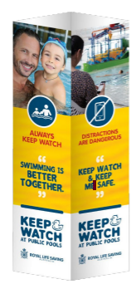
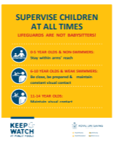


Venue walk through activity
1) Using apiece of paper draw a basic plan of your venue including entry, bathrooms, pools, cafe areas etc.
2) With your drawing (in a different colour) walk around your venue and note where you would place the following Keep Watch resources.
3) upon returning to your group, discuss where and why you chose the placements of the resources.
2x Bollard signs
3x concourse signs
1x box of
wristbands
6x A4 posters
Flyers

Slide 23
Training Scenarios - Role play
Distracted Parent on Phone
Situation: A lifeguard notices a parent of a 3-year-old sitting on the pool deck scrolling on their phone while the child plays in the water nearby.
Objective: Practise approaching politely, reminding the parent of supervision responsibilities, and encouraging compliance without confrontation.
Discussion Prompt: How did the parent respond? What words worked best to de-escalate and reinforce the rule?
Notes:
In this Role play;
Have 1 person act as a parent on the phone, the other person is a Lifeguard.
'Lifeguard' is to encourage the parent to properly supervise the child in the water aligning to the Keep Watch Policy.
'Parent' can be an understanding parent, not interested, aggressive, not understanding the need etc.

Slide 24
Training Scenarios - Role play
Entry Point Education
Situation: A family with two children (aged 4 and 8) comes through the front of house. They don’t know about the wristband system and have not heard of Keep Watch.
Objective: Staff to practice explaining the Keep Watch rules clearly and positively, and fitting children with wristbands.
Discussion Prompt: How can we make the explanation quick, friendly, and clear while avoiding sounding like a lecture?
Notes:
Staff Action: Role-play greeting the family, handing out wristbands, and explaining why they’re important.

Slide 25
Training Scenarios - Role play
Supervised by Older Child
Situation: A lifeguard sees a 9-year-old playing in the shallow water (1.1m) with a toddler, their guardian is chatting with friends across the venue.
Objective: Practice approaching the parent/guardian and reminding them of active supervision expectations for 0-4 and 6–10-year-olds.
Discussion Prompt: How can lifeguards keep the message consistent without seeming too strict? How can lifeguards ensure the safety of the children whilst approaching the parent/guardian?
Notes:
Staff Action: Role-play calmly addressing the situation, highlighting the risk and the Keep Watch rule.

Slide 26
Training Scenarios - Role play
Escalation & Teamwork
Situation: A parent becomes defensive after being reminded twice about supervision requirements for their toddler.
Objective: Practice escalation pathways — when and how to involve a supervisor or team leader, and how staff can back each other up.
Discussion Prompt: How do we support one another in difficult situations? What’s the balance between firmness and customer care?
Notes:
Staff Action: Role-play lifeguard making the initial approach, then involving a manager to reinforce the message.

Slide 27
Quiz
Test your teams knowledge on Keep Watch; join in teams, pairs or individuals and have fun!

Slide 28


Thank you

